Slide 1
DATASET DISTILLATION
distill the knowledge from a large training dataset into a small one

Slide 2
Different with dataset pruning
Dataset pruning constructing these subsets require many more training examples per category than dataset distillation, in part because their “valuable” images have to be real, whereas our distilled images are exempt from this constraint.

Slide 3
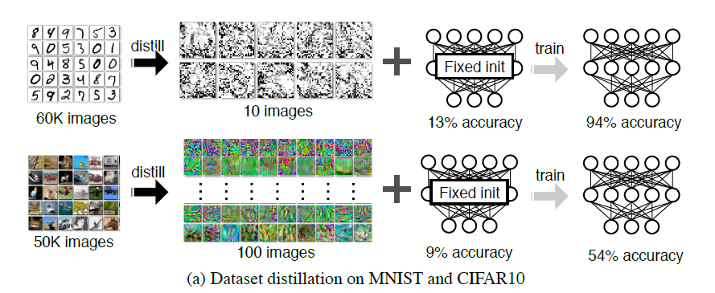
PERORMANCE

Slide 4


APPROACH
One step GD, fixed initialization:
One step GD, random initialization:

Slide 5
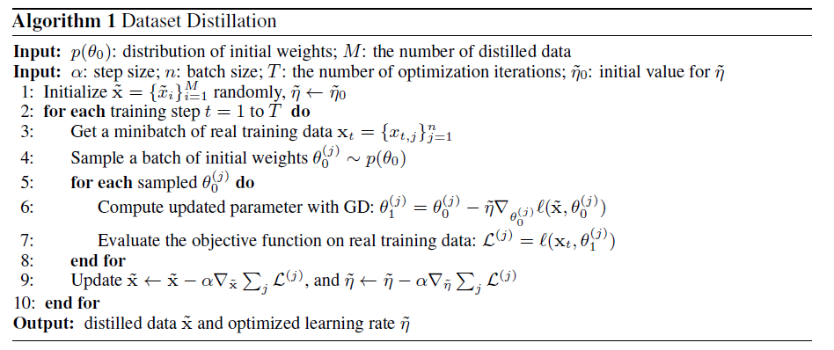
Algorithm

Slide 6

Algorithm: Multiple steps

Slide 7
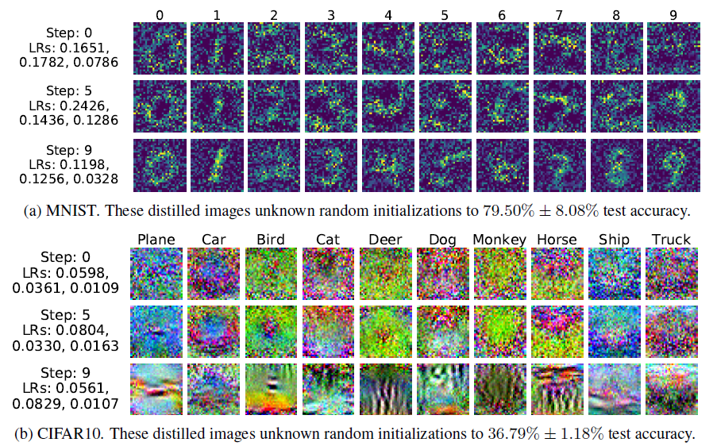

Slide 8
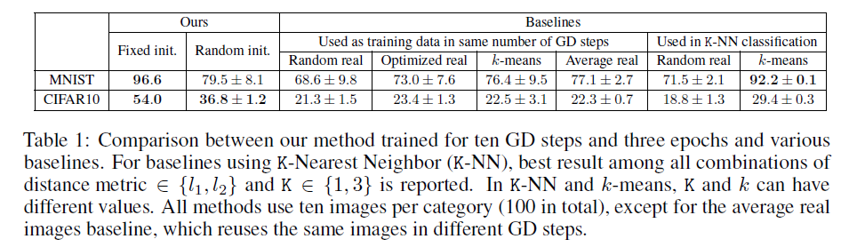

Slide 9
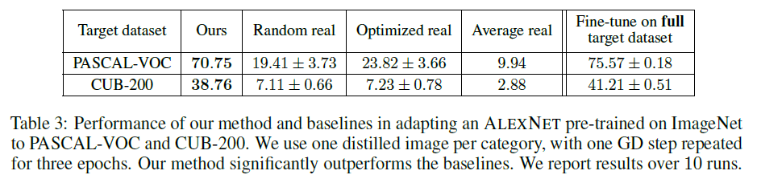

Slide 10
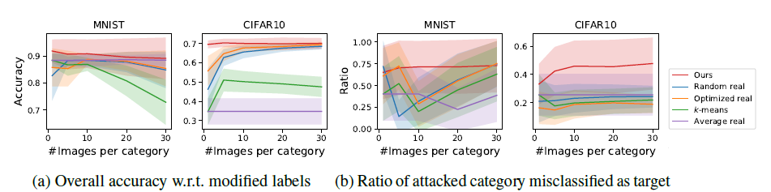

Slide 11
Perhaps the paper would be better motivated by finding a realistic scenario in which it would make sense for someone to use this approach over reasonable alternatives.

Slide 12
Improvement for our platform
GD updates inputs x together with label y

Slide 13
Other way to generate
《MIXUP：BEYOND EMPIRICAL RISK MINIMIZATION》
《Large Scale Adversarial Representation Learning》
《Learning Data Augmentation Strategies for Object Detection》

